Slide 1







offering inspiration
discover training resources
recognition as an author
facilitating to complement resources
https://www.flaticon.com/
https://www.freepik.com/

Slide 2


Slide 3

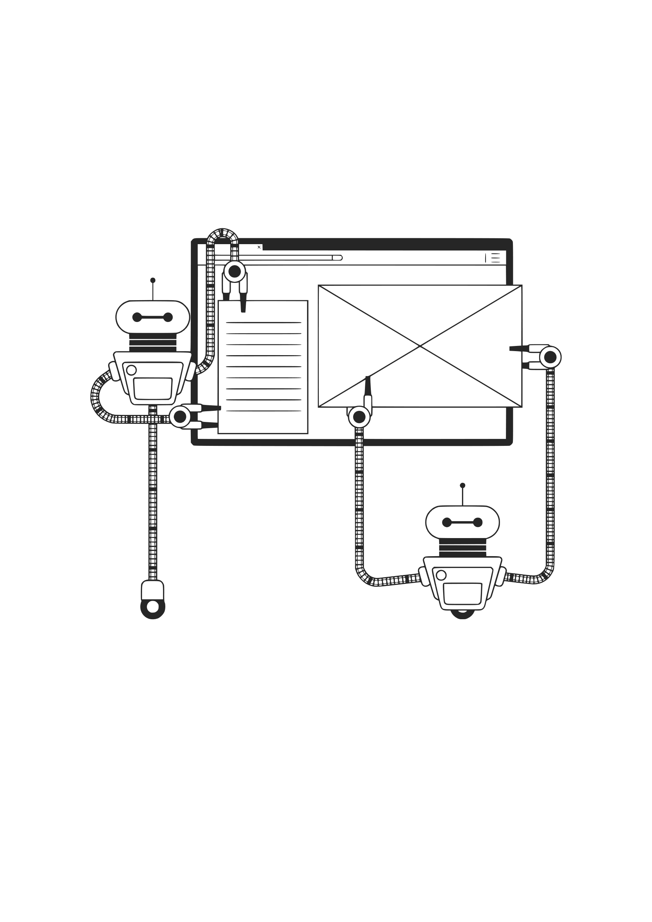

{
“@id” :
”https:// …”
“@type”:
“Course”
“keywords”: “Training“
}
{
“@id” :
”https:// …”
“@type”:
“Course”
“keywords”: “Training“
}
{
“@id” :
”https:// …”
“@type”:
“Course”
“keywords”: “Training“
}

Slide 4
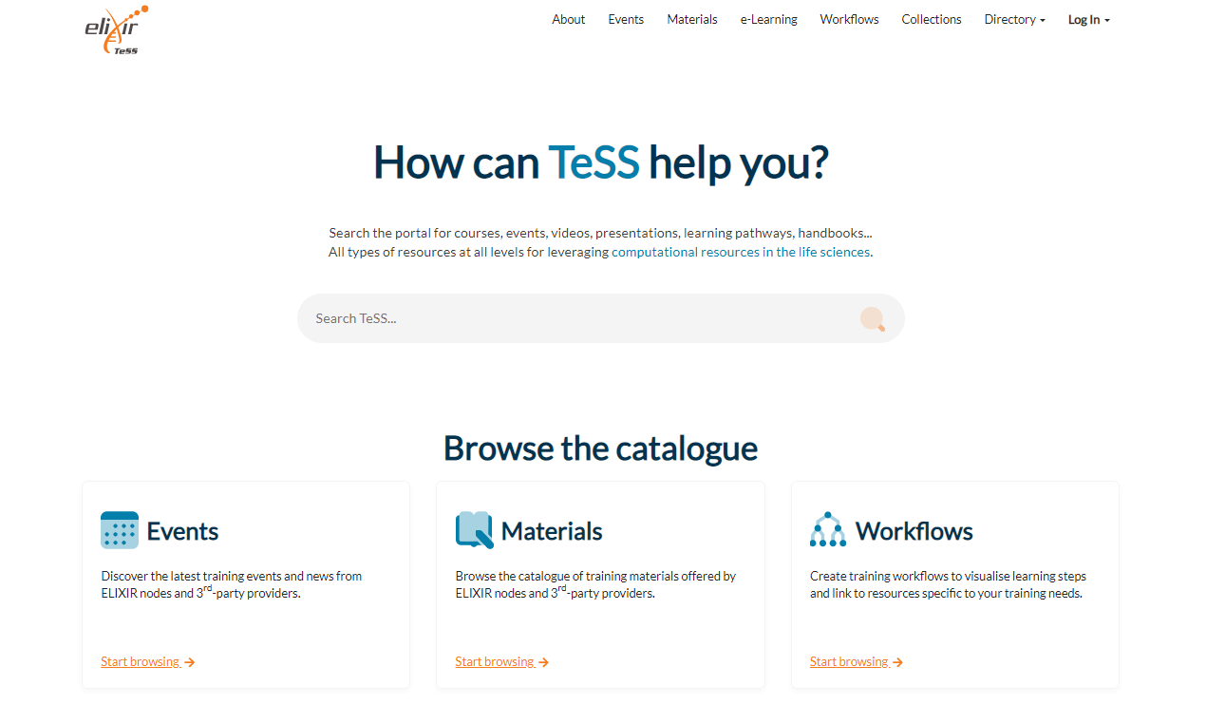


General Search
Filter by session

Slide 5
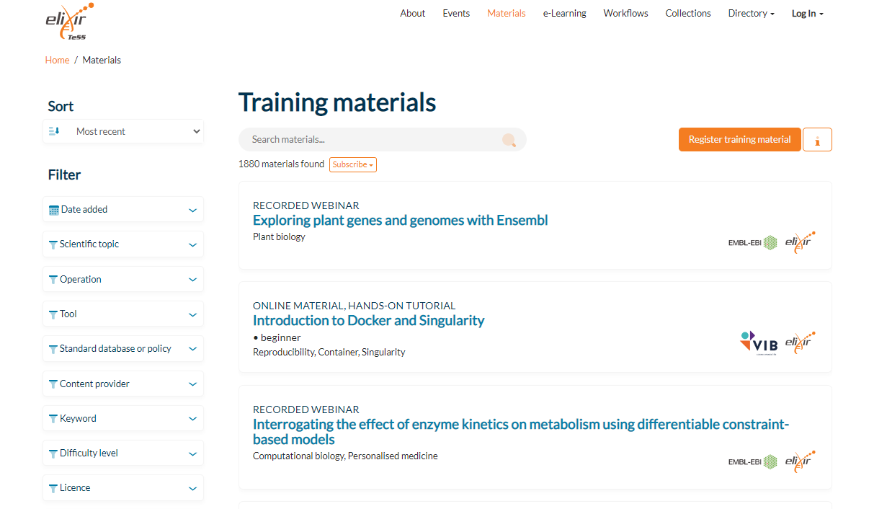

General Search
Filter by session

Slide 6

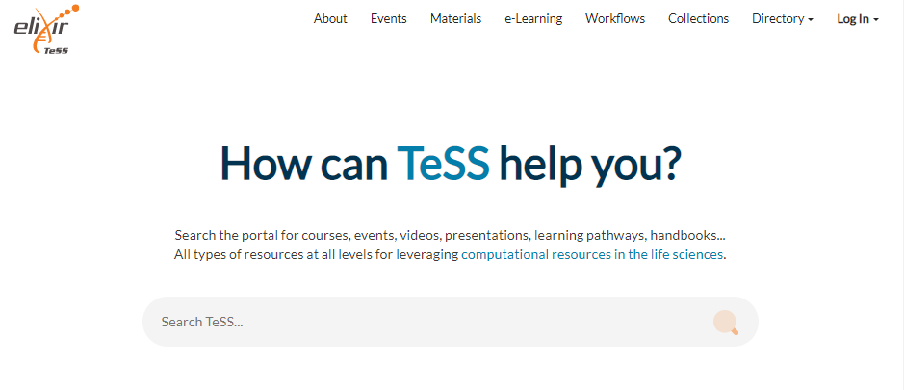

Filter by session
General
Search

Slide 7

Filter by online self learning

Slide 8
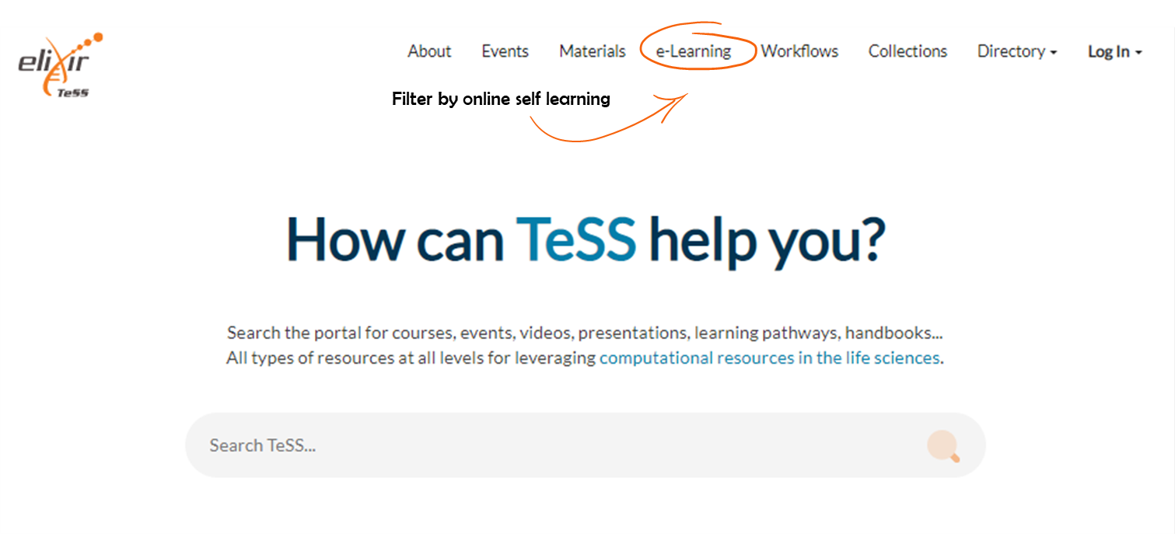
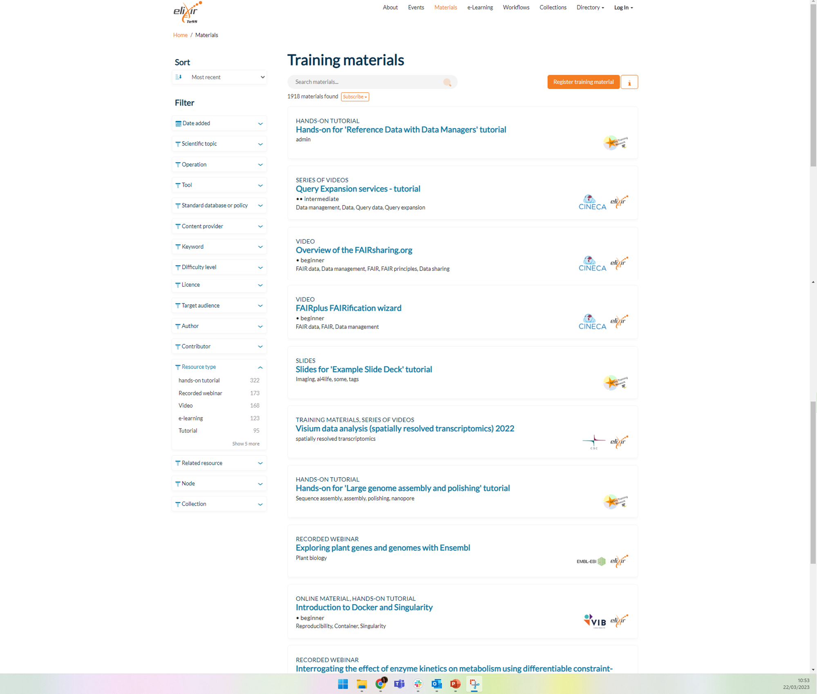
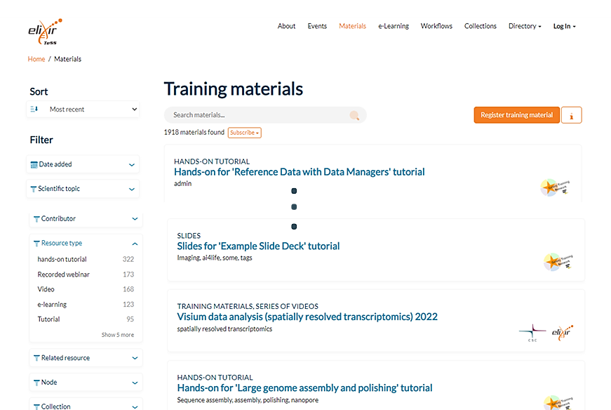


.
.
.

Slide 9
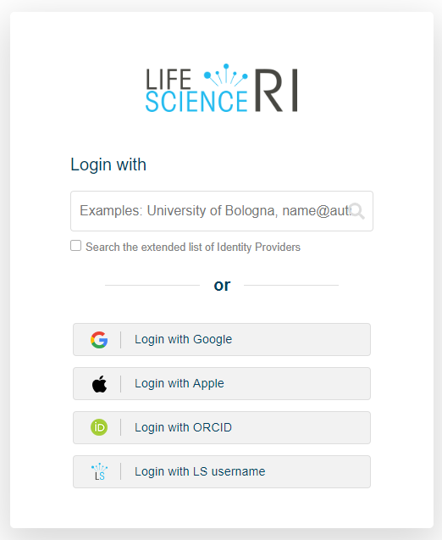

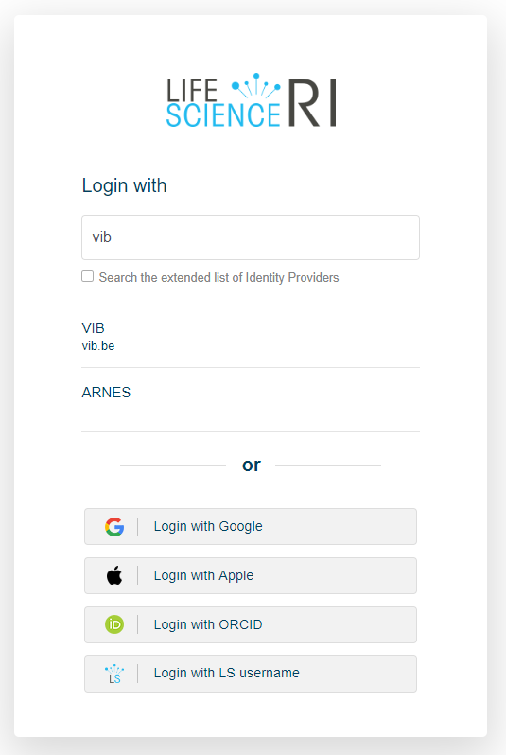


Filter by online self learning

Slide 10
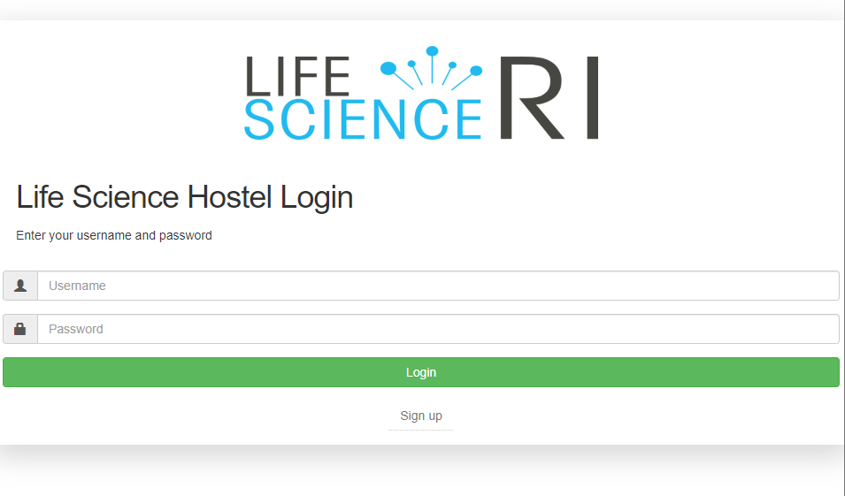


Slide 11
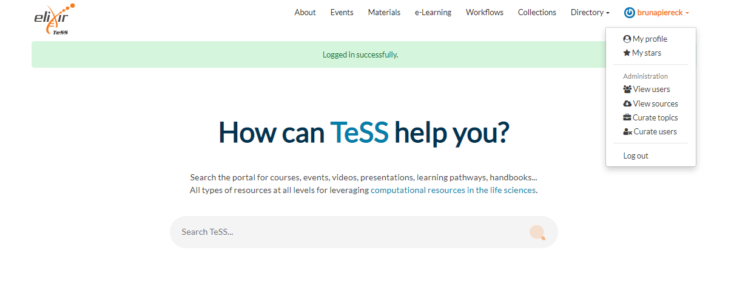



name

Slide 12









Training material
Course instances
dd/mm
Course
Event
dd/mm
dd/mm/yy
Description
location
dd/mm
Meta-info
dd/mm

Slide 13




Training material
Event
Course instances**
Training material
Event
Course**
dd/mm
Description
dd/mm
location
dd/mm
Meta-info
** In TeSS these are called Event, but this is not the same as the schemas profile EVENT. For the automatic scraping we advise to use, the COURSE and COURSE INSTANCE profiles.

Slide 14
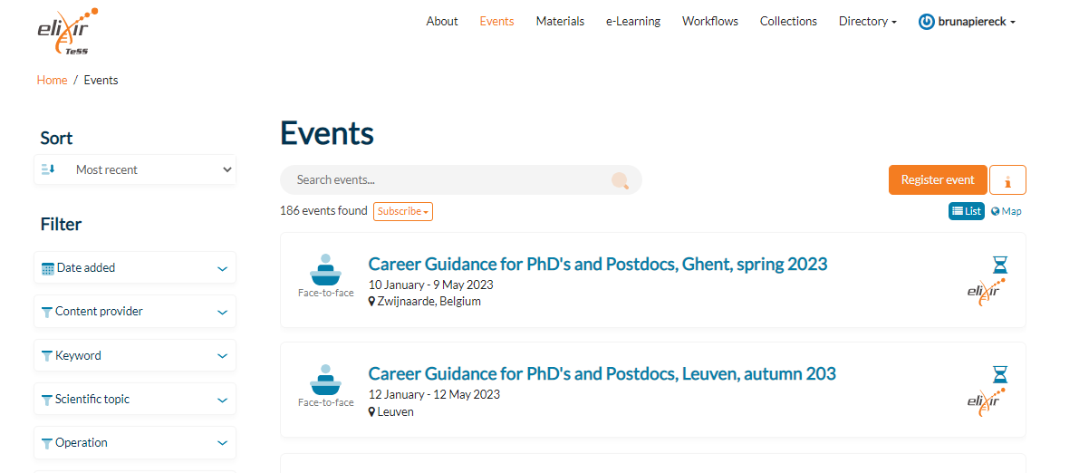

name

Slide 15
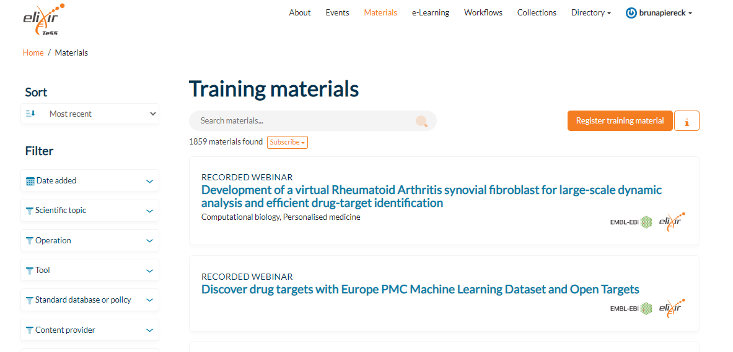
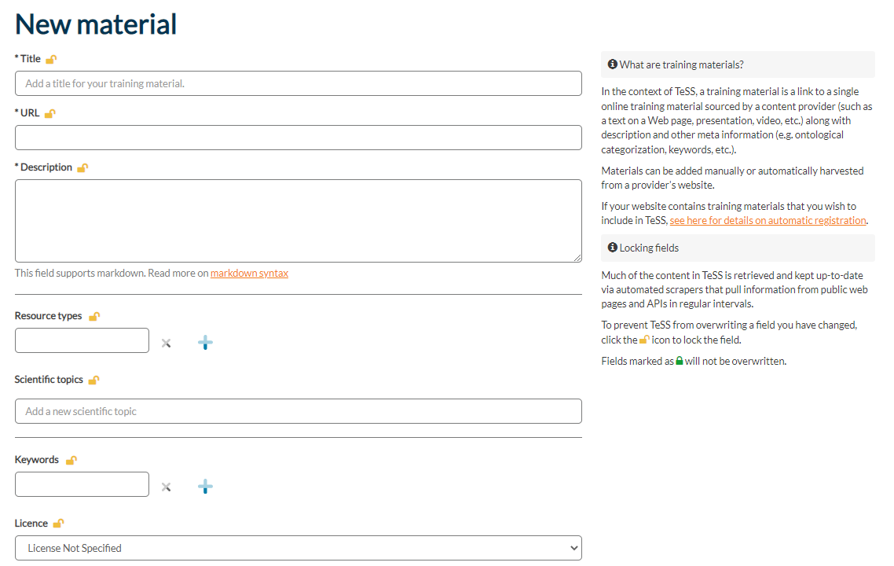

name

Slide 16







Training material
Reading material
Presentation
https://link2materialpage.com
Video
Description
Activities/Scripts
Meta-info
Etc …

Slide 17
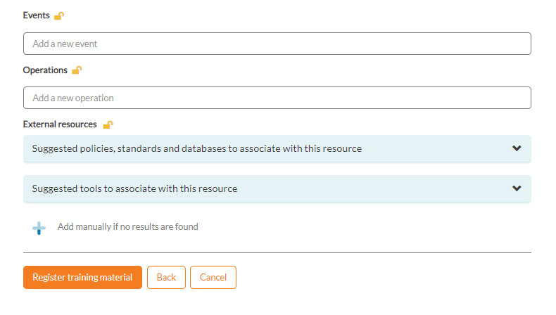

Slide 18
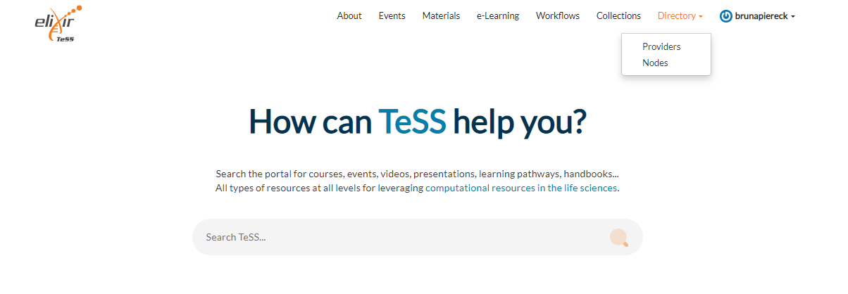
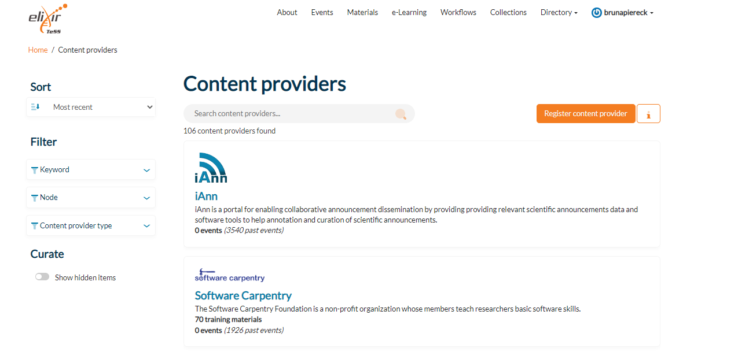
name
name

Slide 19
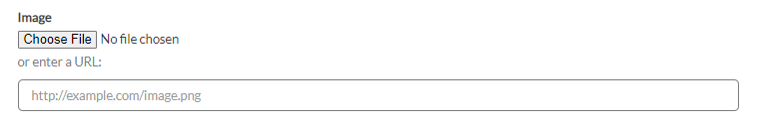

Slide 20
Event 2
Event 1
dd/mm
Course 1
Course instance A
Material v 1.0
Course 2
Course instance B
Course 3
Course instance C
Material v 2.0

Slide 21
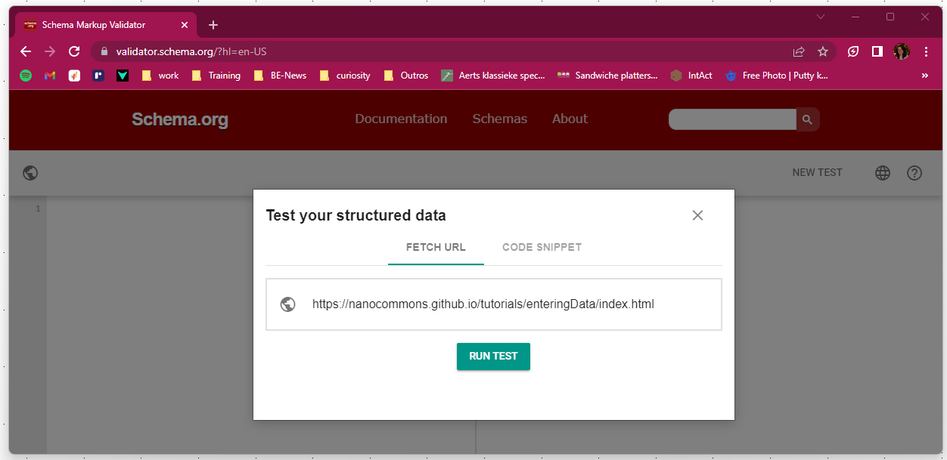

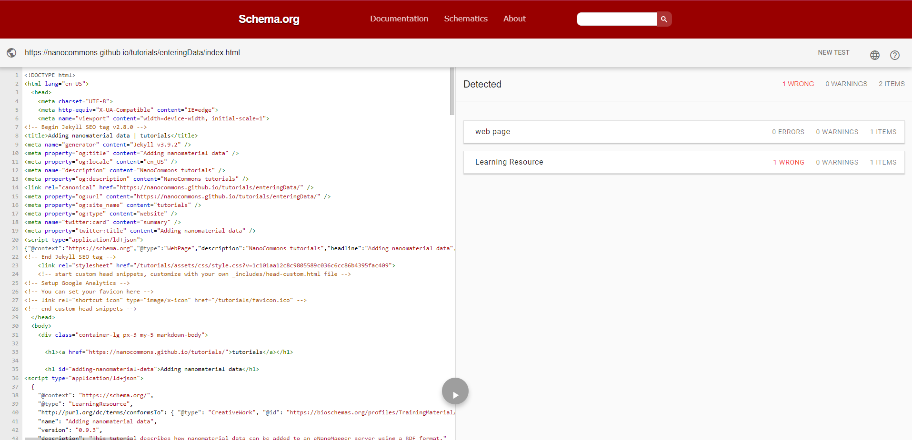
Validator.schema.org/?hl=en-US

Slide 22
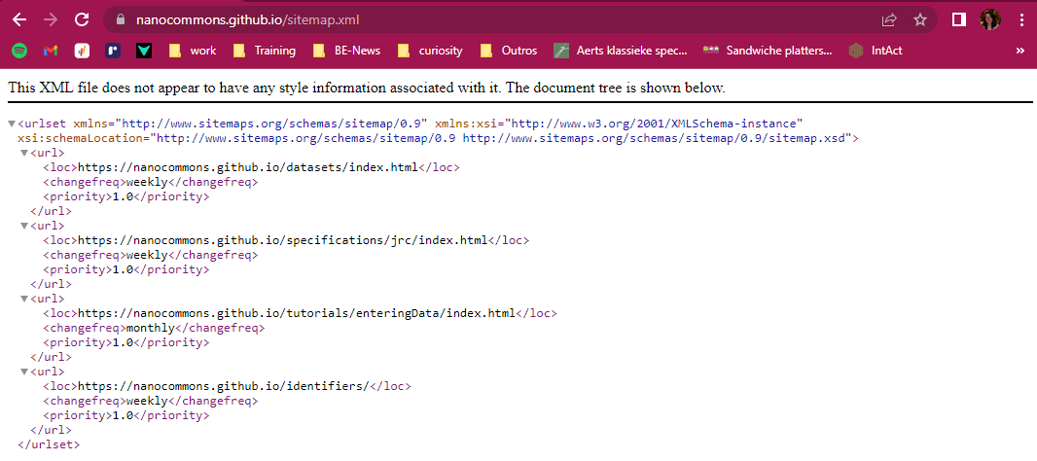
Site map

Slide 23
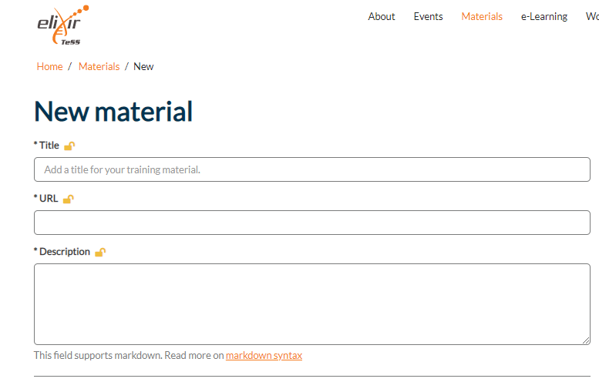



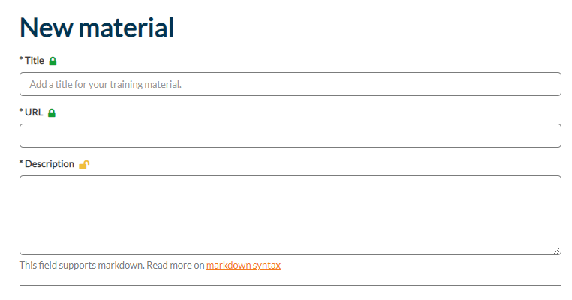
Can get overwritten
Won’t get overwritten

